Slide 1
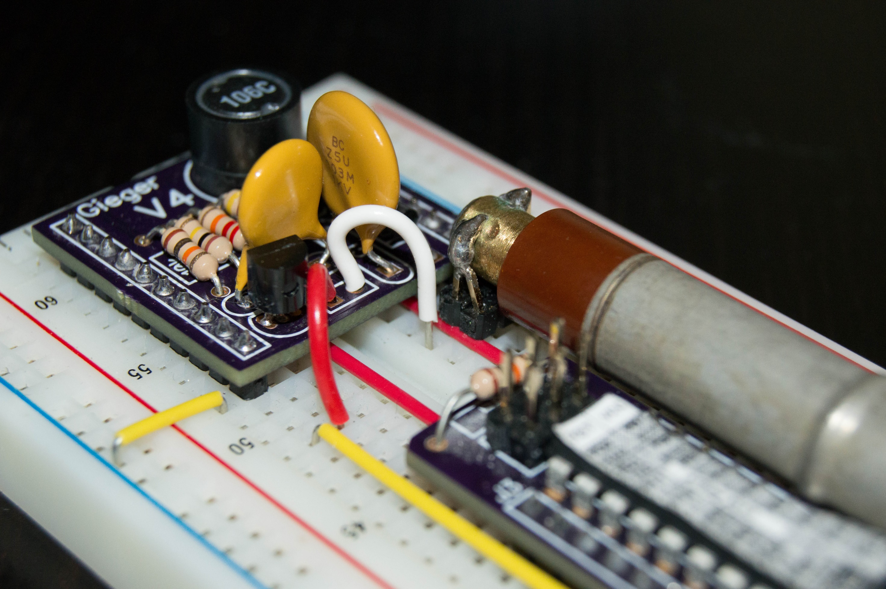
Networked Radiation
Update 09/26/2014

Slide 2
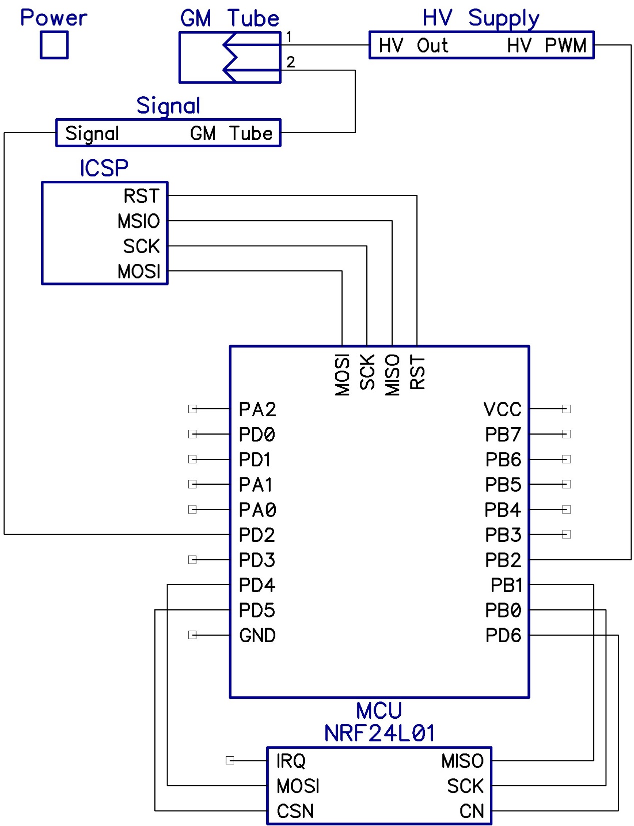
General Circuit
Hierarchical Block Diagram of Schematic

Slide 3
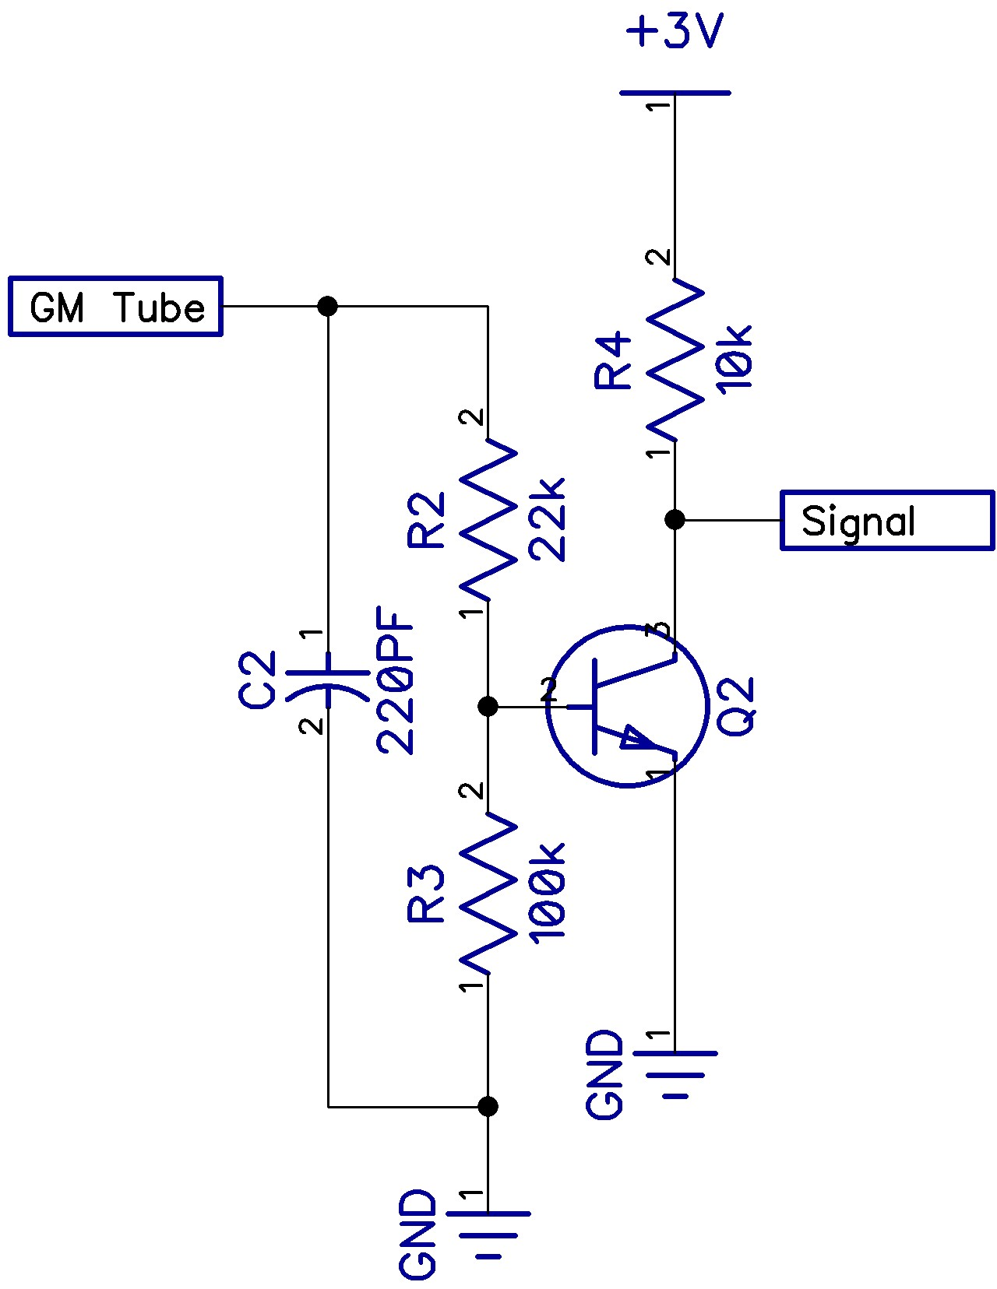
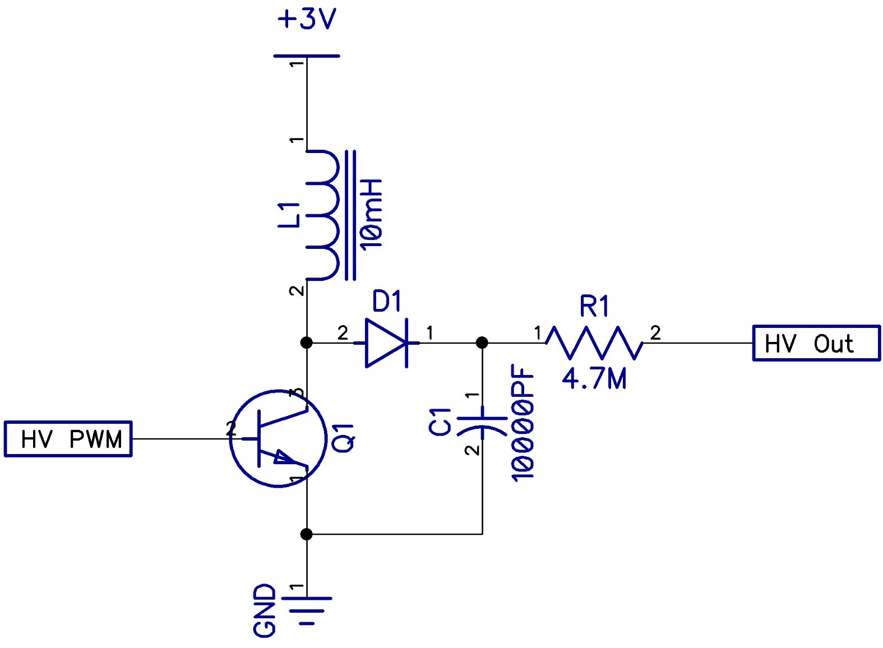

Slide 4
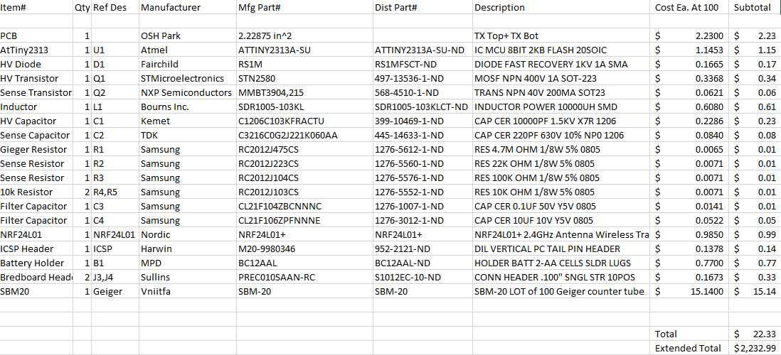
BOM, Cost at 100 Units

Slide 5
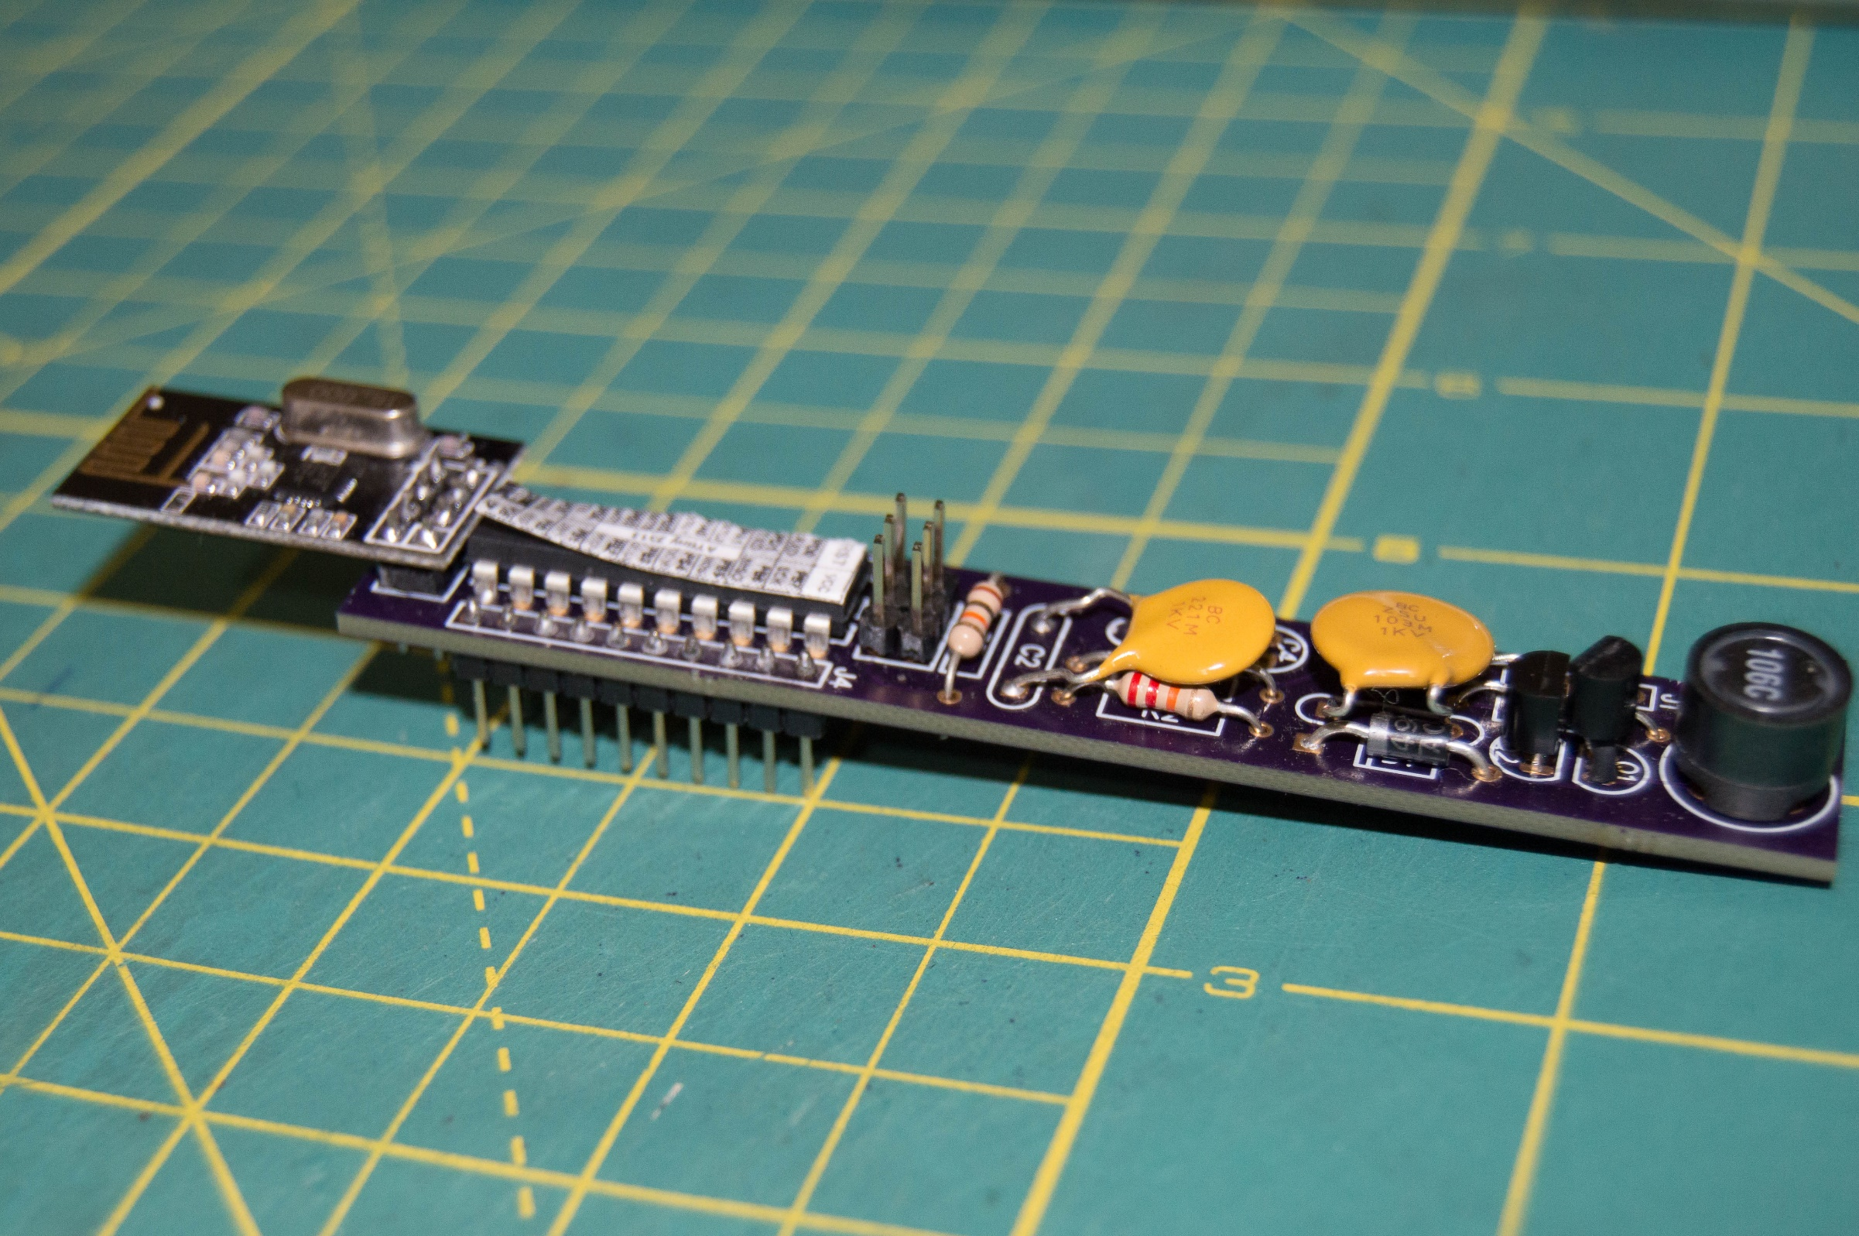
Board V1

Slide 6
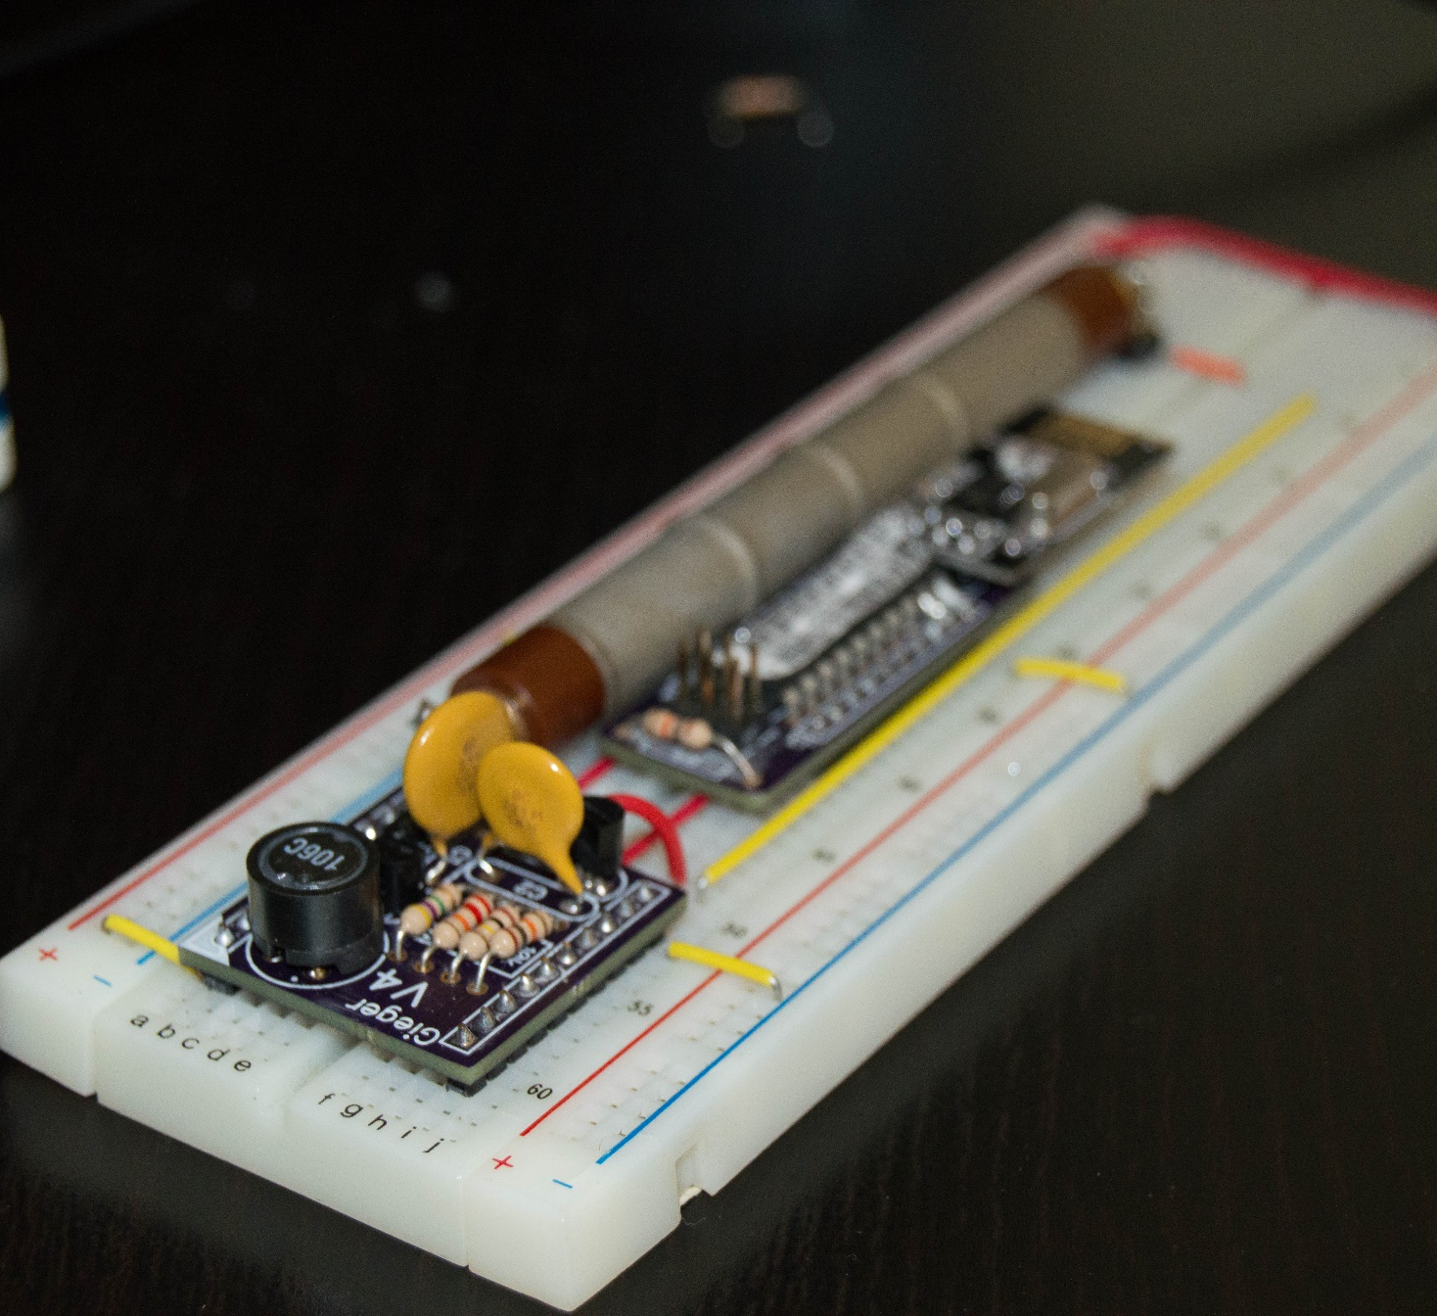
Board V4
Wireless and AVR from V1
Just HV Supply
Transmitting and Collecting Data

Slide 7
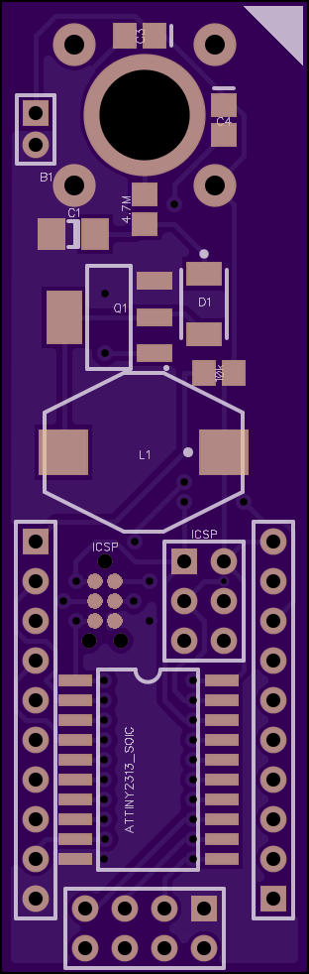
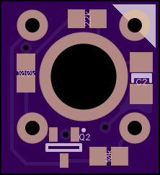
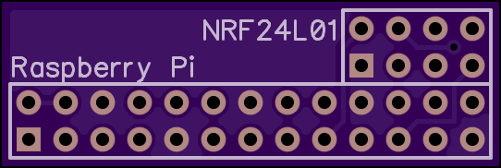
PCB V6

Slide 8
Immediate Steps
Build array of 10 modules
Write NRF Transceiver Module Raspberry Pi data logging
Network test, Collect data into SQL DB

Slide 9
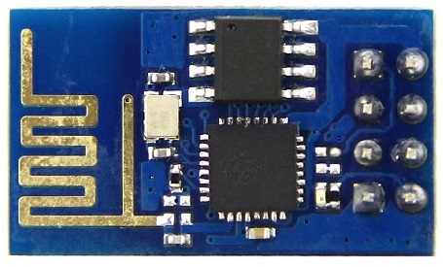
Future Hardware
Wi07, ESP8266 WiFi Module
Separate boost controller (power reduction)
More sensors after a few more Iterations

